Slide 1
Staff Application
Developed By Joseph Kilbane

Slide 2
User Stories and key areas for the application
As a staff member I would like to view all journeys.
As a staff member I would like to see additional information for journeys (bookings and platform information).
As a staff member I would like to view my personal shifts.
As a staff member I would like to edit my profile.
If I have the default password, I would like to be told to change it.
As a staff member I would like to sort the tables to view a specific shift or journey.

Slide 3
Staff application- technical details
Model-View-Controller based application
Secure Login
Multiple Threads for auto-updating
Touch screen suitable layout
Professional look and feel
Unique login
Logout
Junit testing

Slide 4
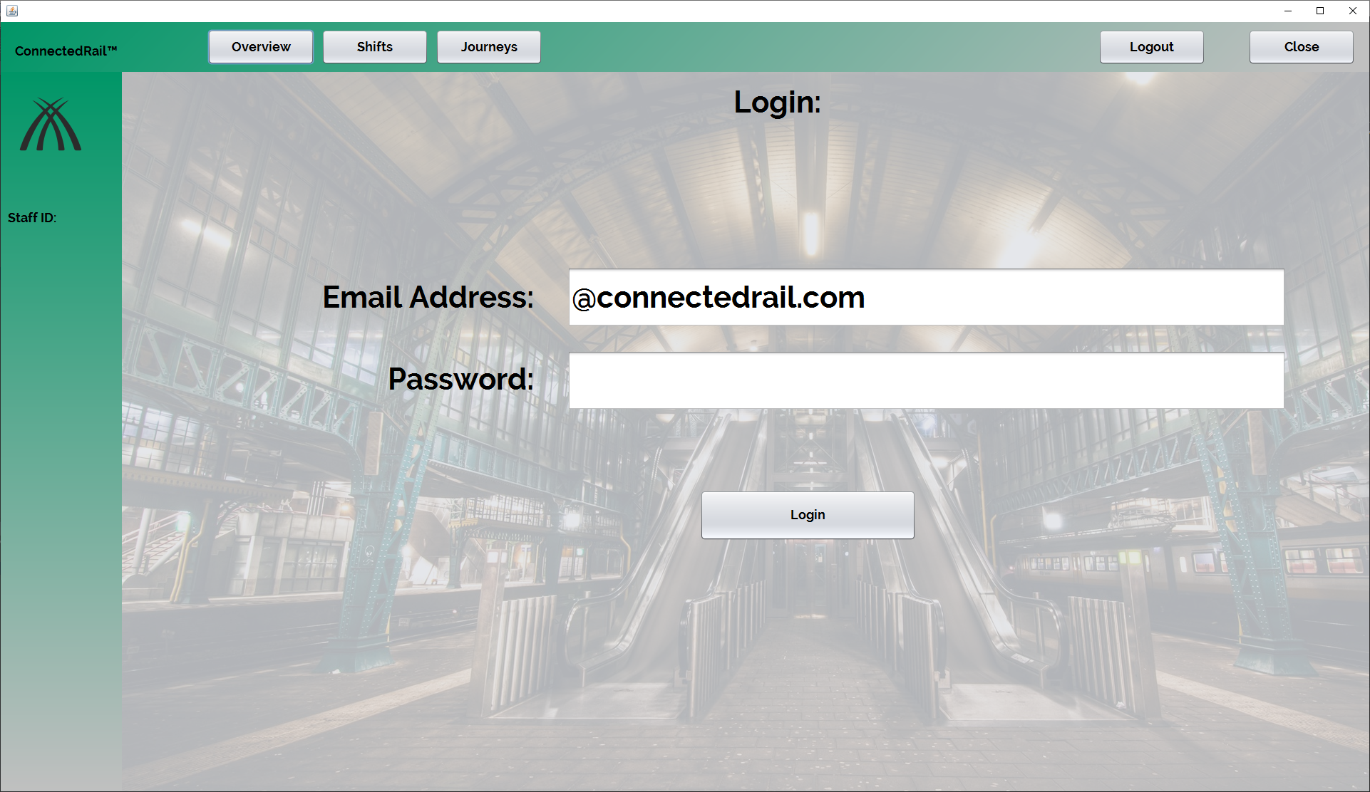
Logging In and General Design
The email address is partially filled just for usability.
The general design is in-keeping with the web.
Large and clear buttons and fonts are used.

Slide 5
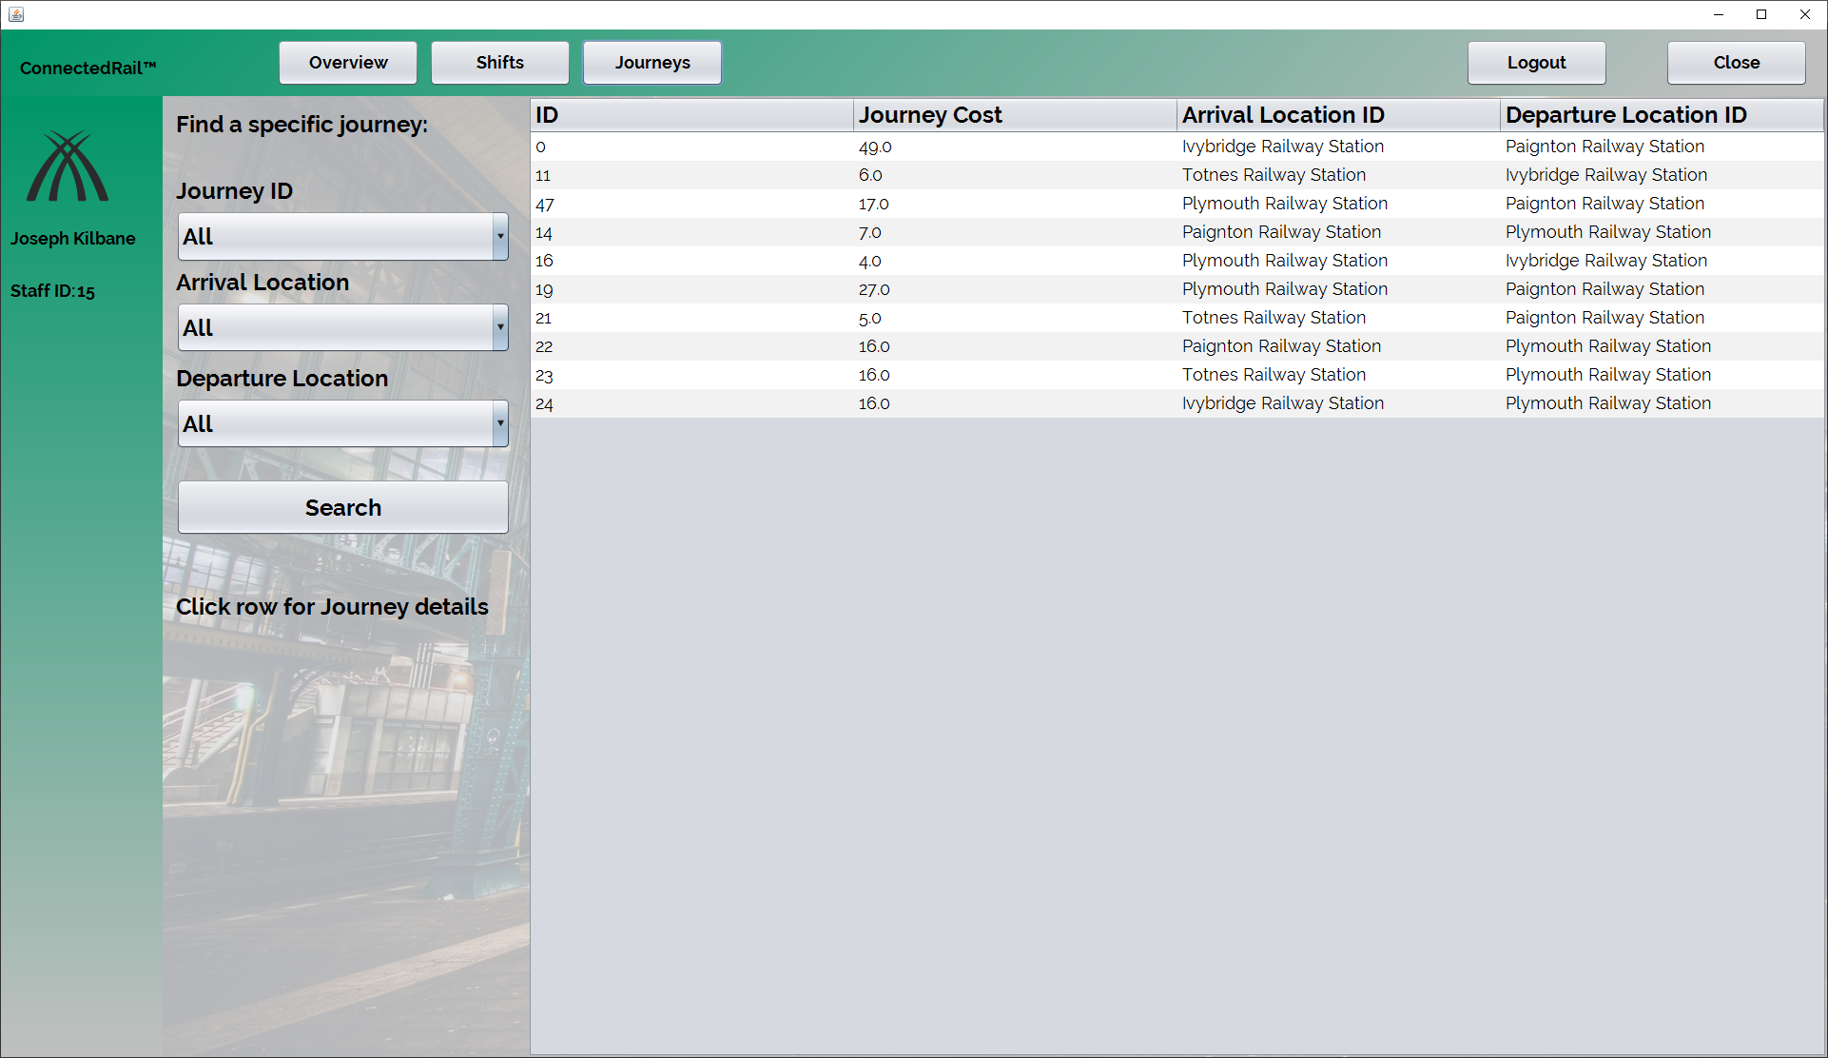
Viewing Journeys
This is the default view for the journey table, from the side you can see that there are several combination boxes, which only show the available options, to sort the tables.

Slide 6
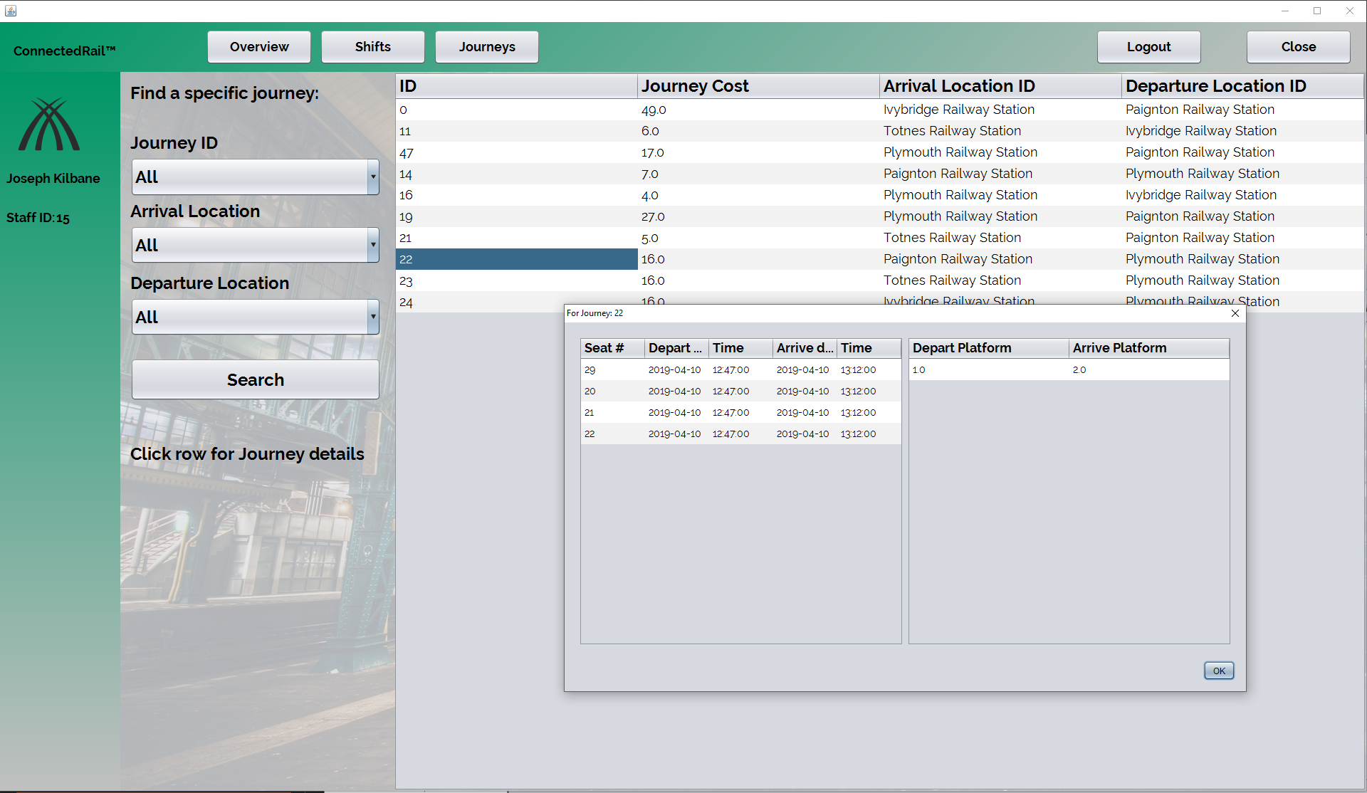
Additional Journey Details
This is the message box that appears when the user clicks a specific row. The row shown is for journey 22, you can see the seats that are booked on the journey with time and date with platform information.

Slide 7
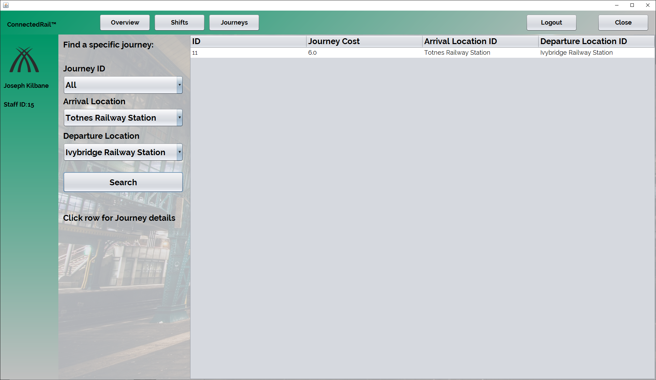
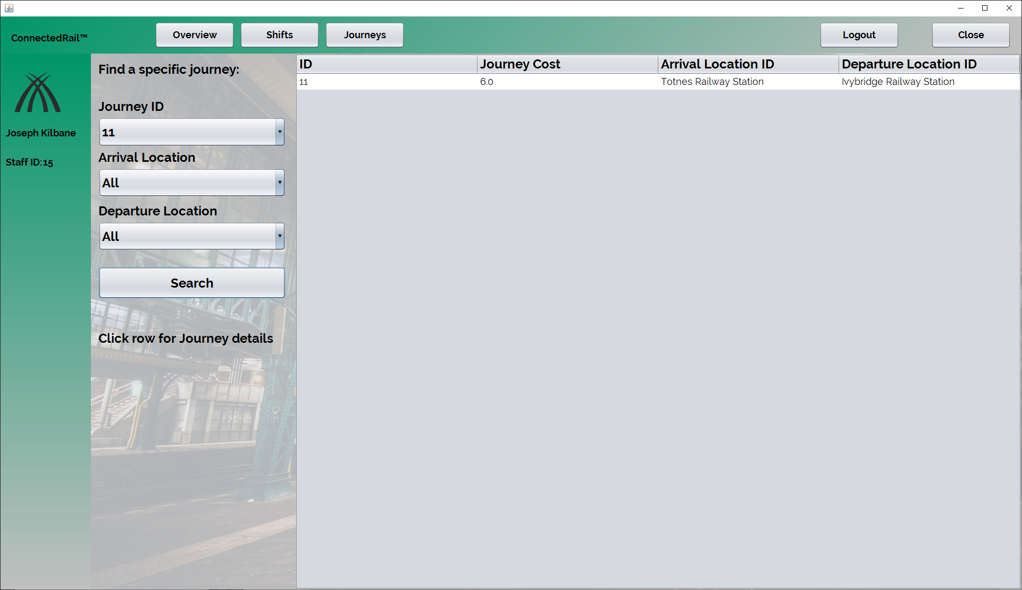
Sorting table
As shown, the combination boxes can be used in unison to find a specific journey is the user is unsure of the journey ID.

Slide 8
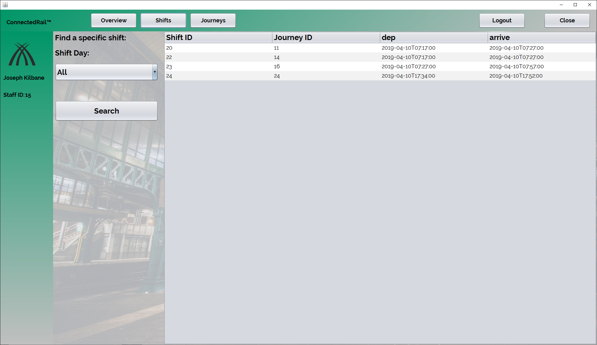
Viewing shifts
This is the shifts table, this table shows the information about what journey the logged in staff member is assigned to.

Slide 9
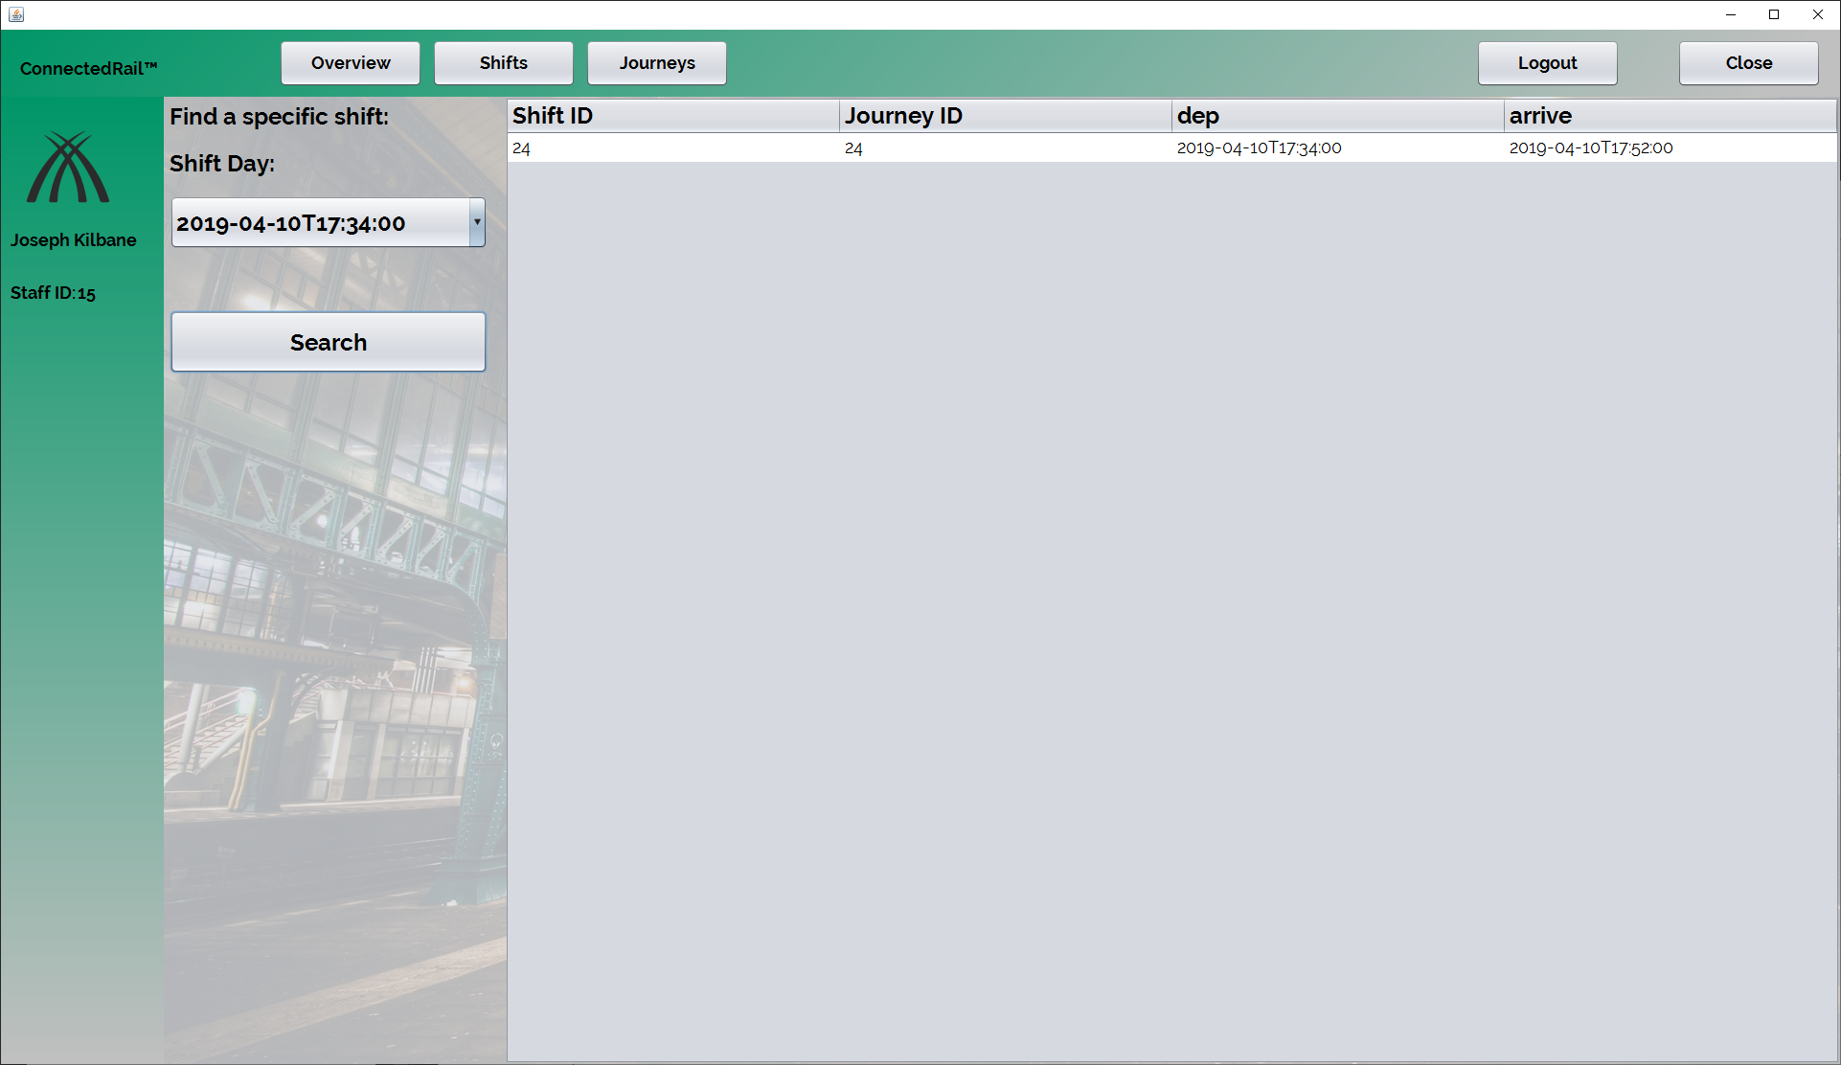
Sorting the table
The drop down menu allows the staff member to view only specific shifts.
The times in the drop down are the departure date/time, e.g. the start time of the shift/trip.

Slide 10
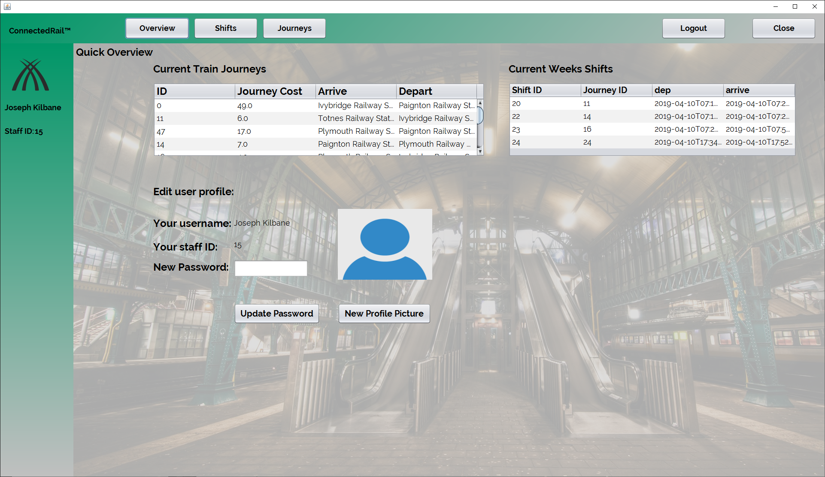
Overview Page
During development, it was decided to have an overview page to allow the user to edit their profile.
Two mini versions of the tables are shown for a ‘quick view’ of the shifts and journeys.

Slide 11
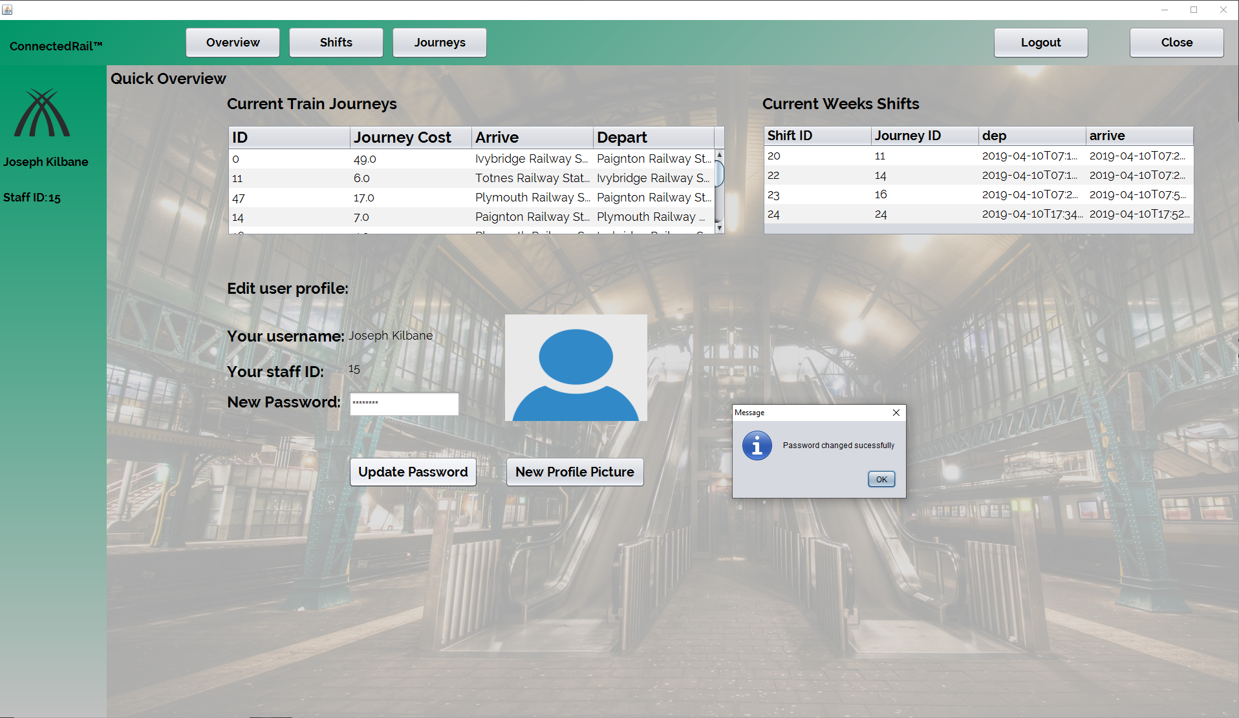
Changing Password
This page also allows the user to change their password, we felt as a team that this should be the only detail they should be able to change.
You are given the shown dialog after clicking update password.

Slide 12
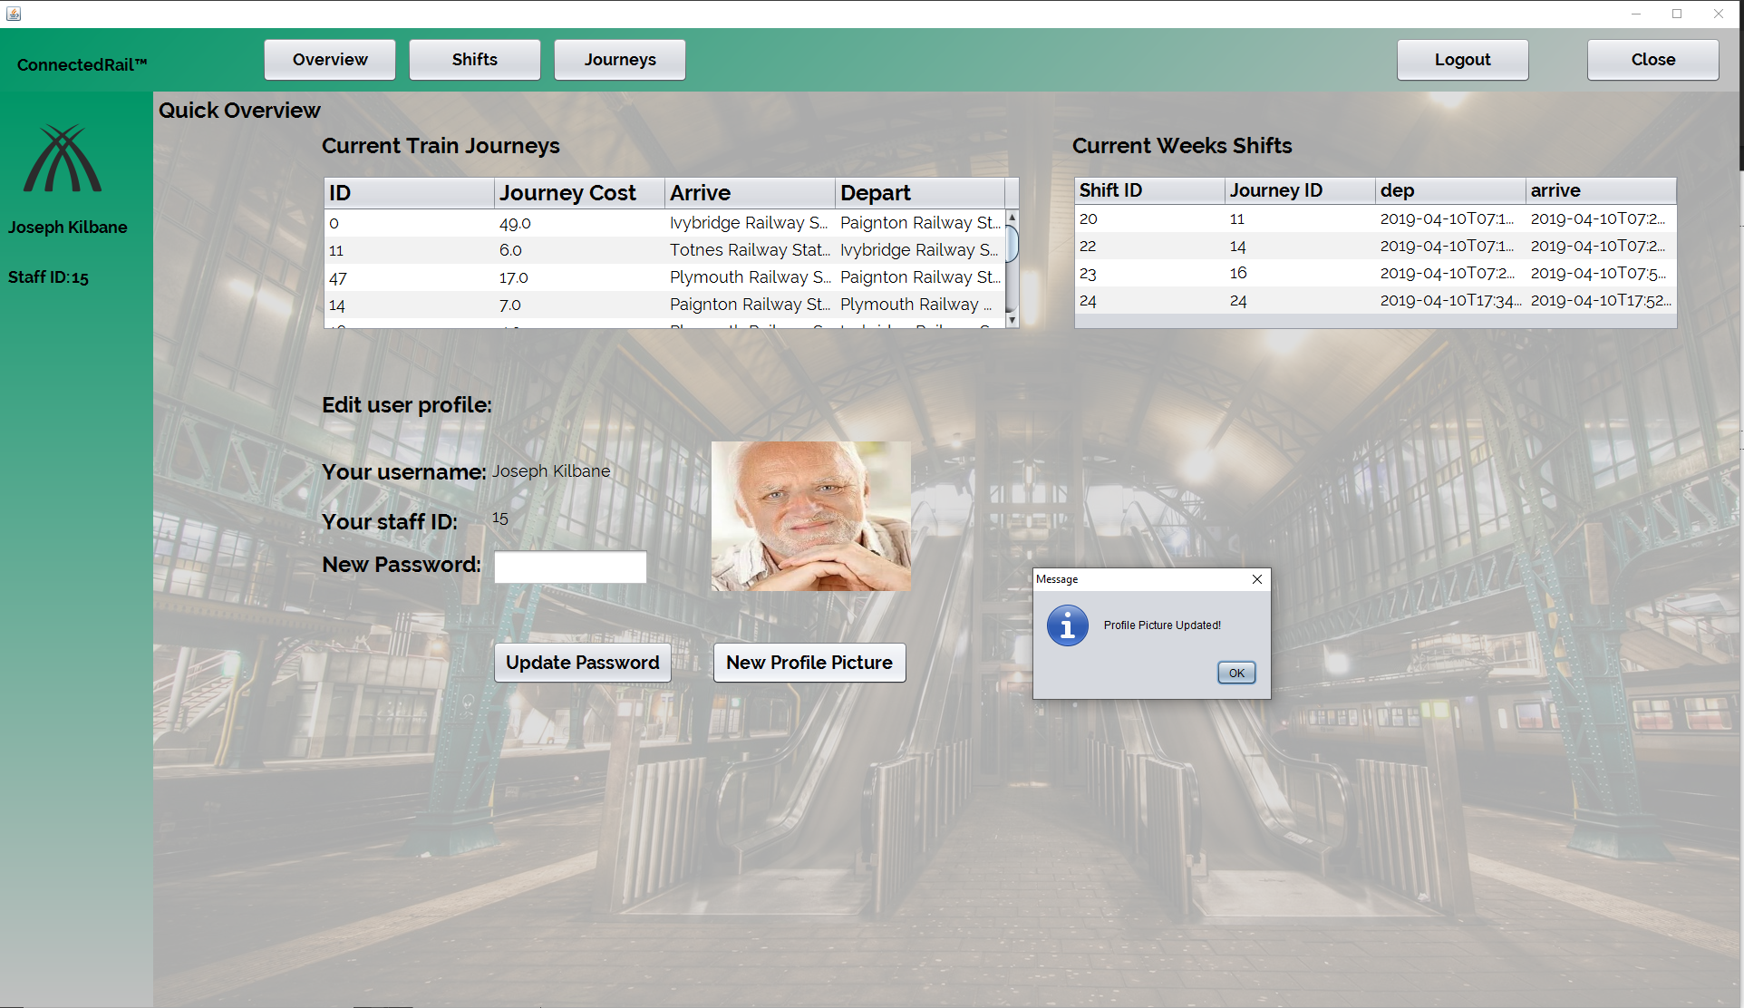
Feature in progress- profile picture
The ability to change your profile picture had to be changed due to development reasons, API issues.
The program currently will only show your new profile picture but not save it.
However there is commented code in the program to convert the image into a BASE64 string and then compress it.

Slide 13
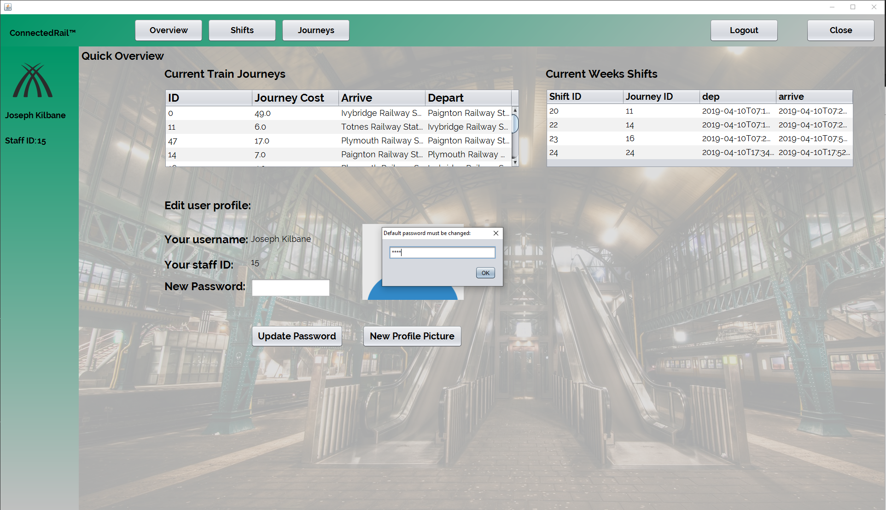
Default Password Change
When the admin creates a staff account, the account is given the default password of ‘password’.
For security reasons we decided to have a prompt to tell the user to change the password.
This appears after logging in immediately.

Slide 14
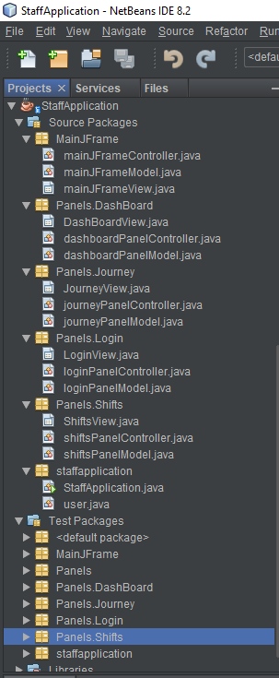
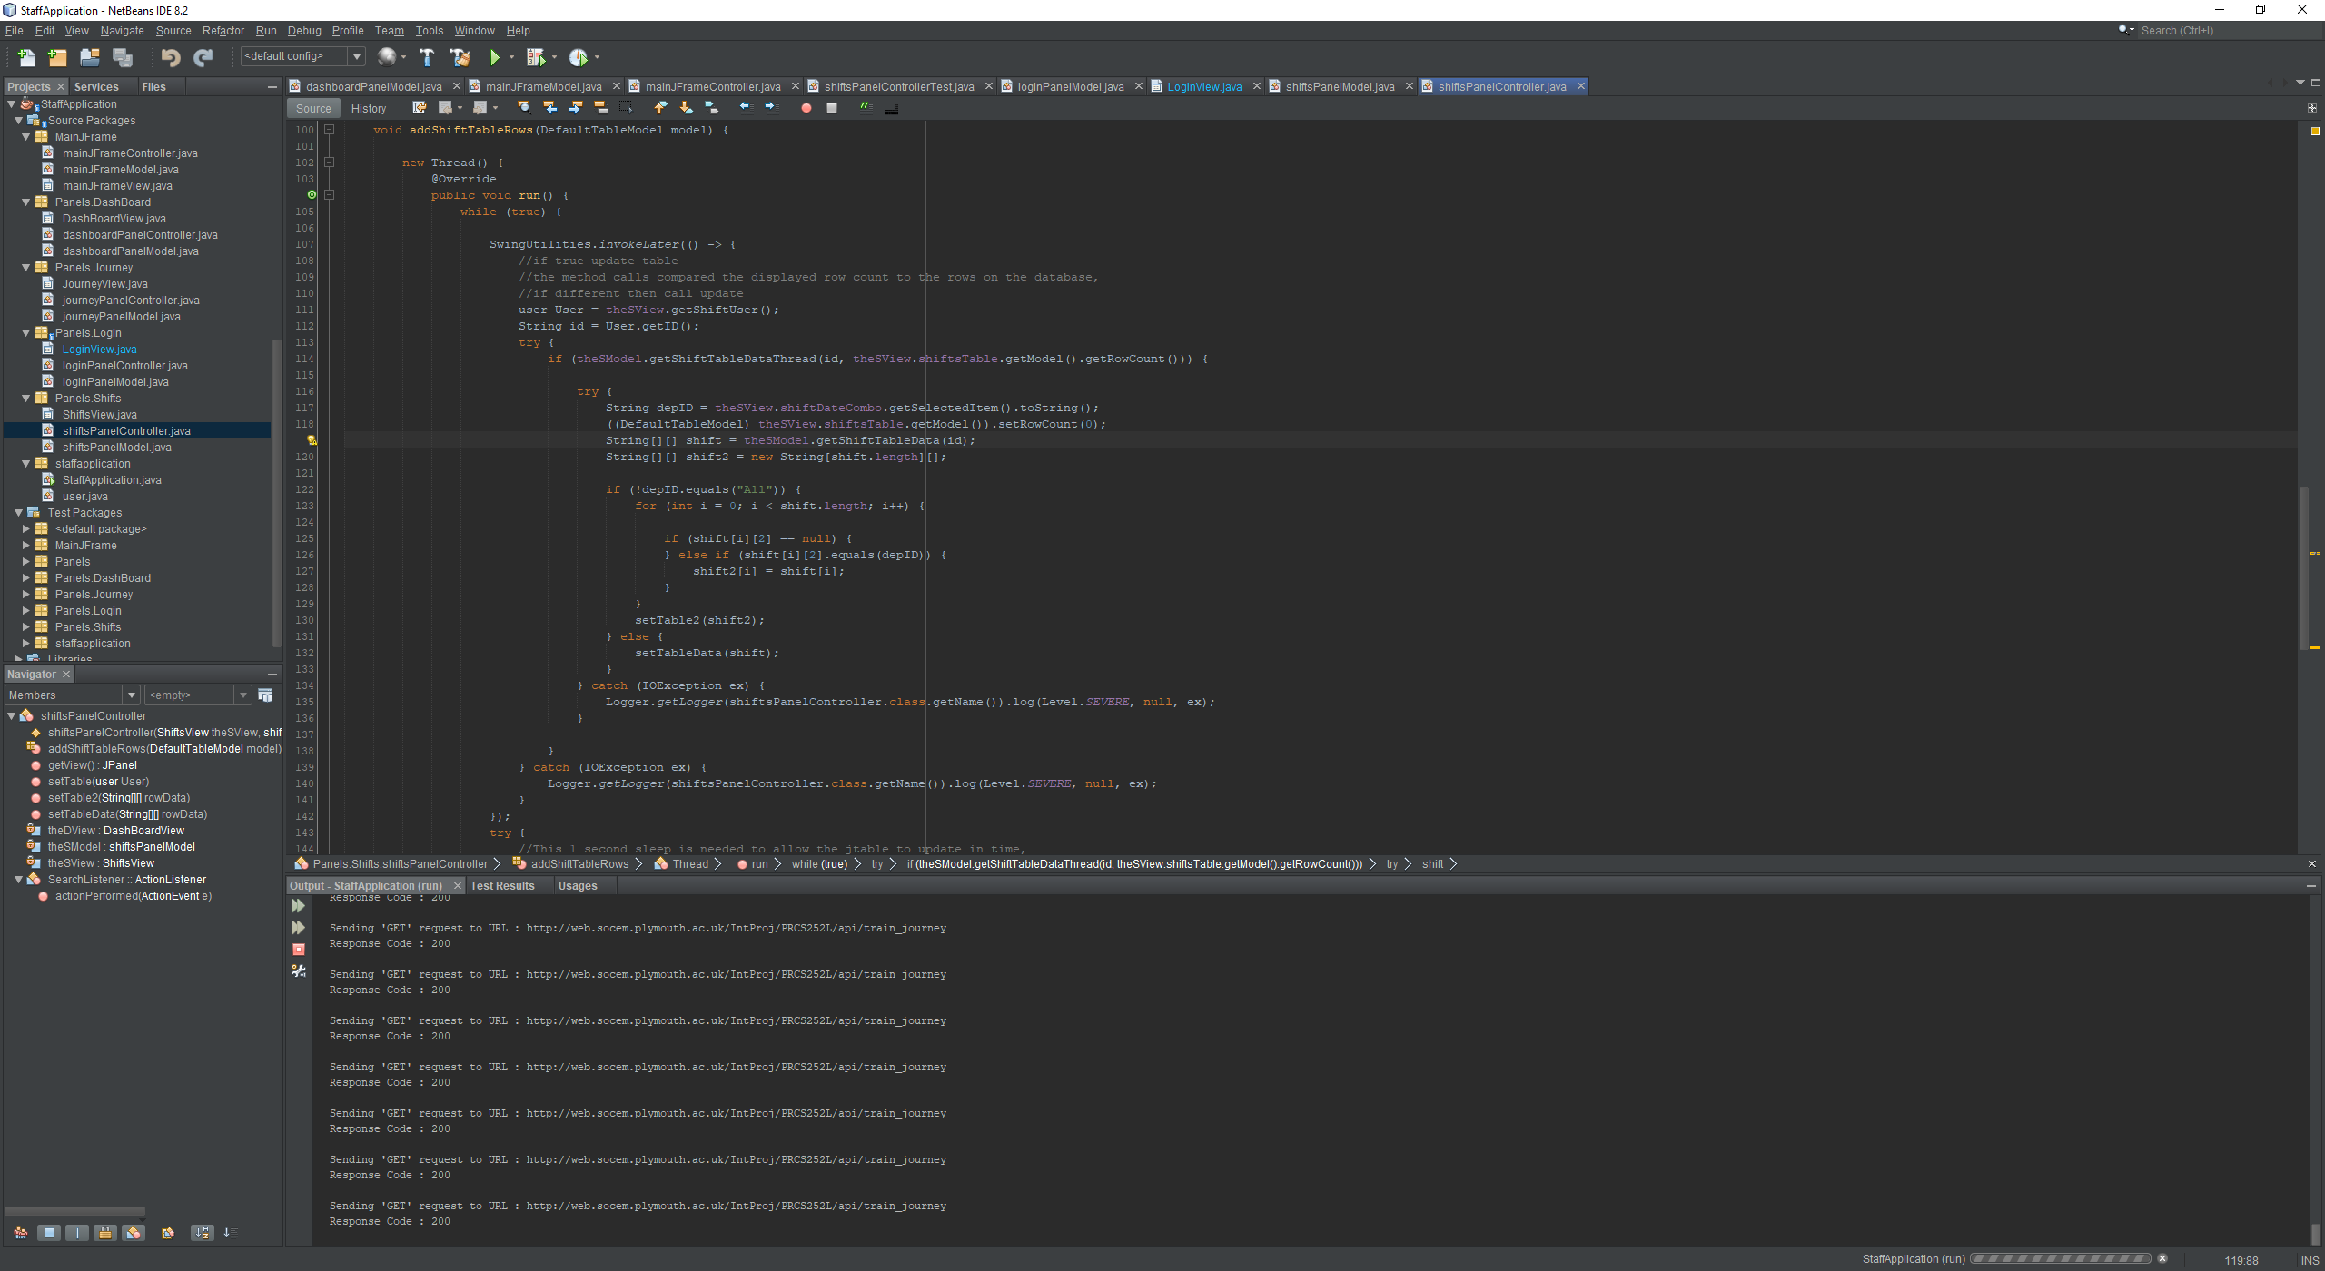
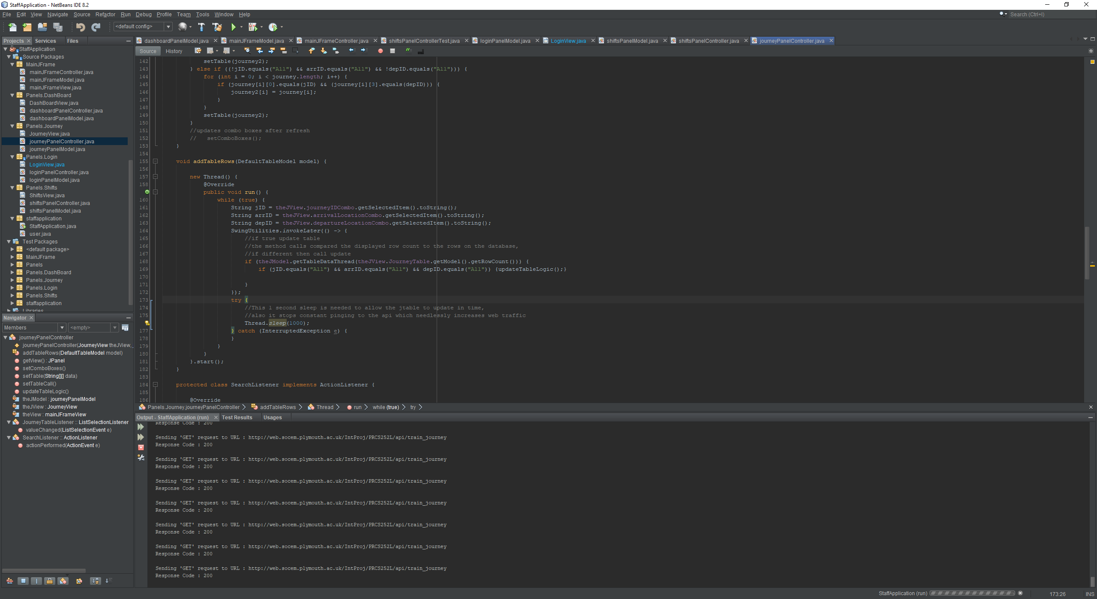
Technical Details
The application is developed with the MVC style.
This means that the view, logic and data is broken into different areas and also allows the models to be used independently.
This was an effective route, as it allowed the overview page to directly call the two table models instead of rerunning the same code in a separate model.
Threading within the models constantly checks to see if there as been an update to the database, and pushes the update within seconds to all relevant tables.

Slide 15
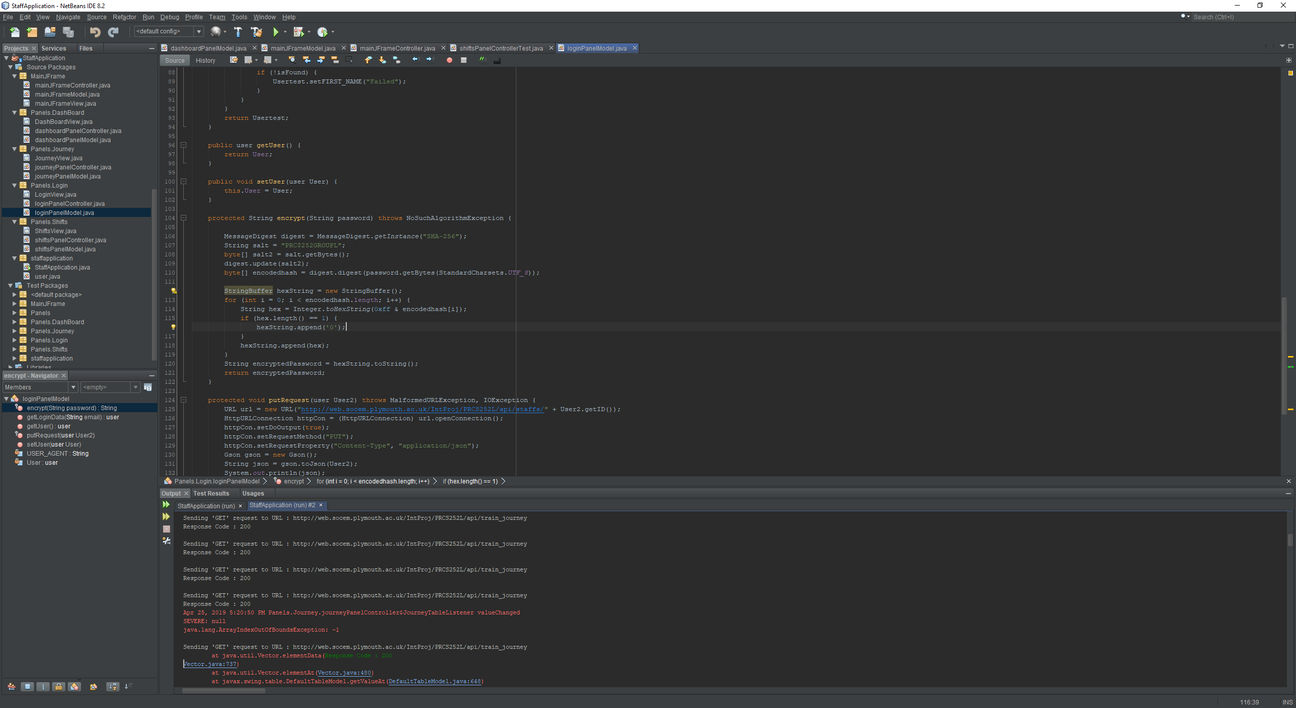
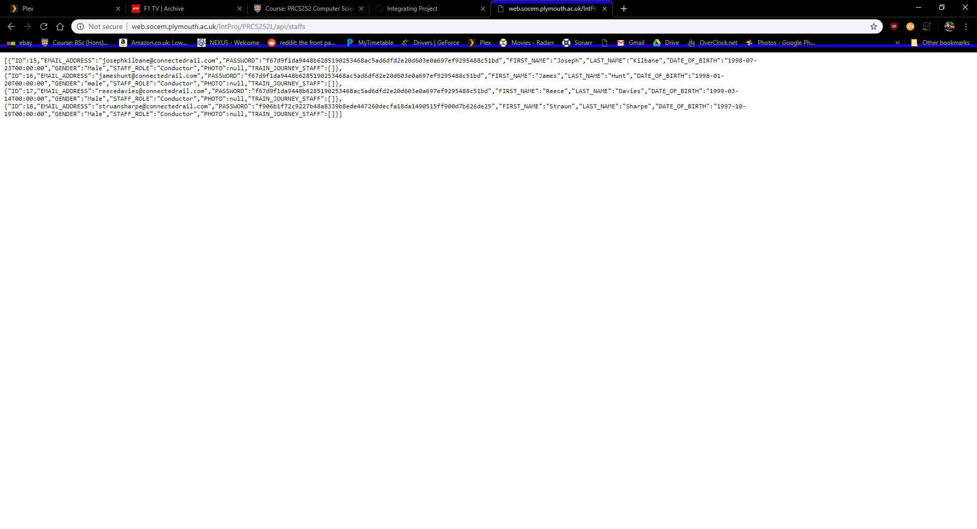
Security
In this project, we decided to all use SHA-256 and the salt of PRC$252GROUPL to salt and hash the passwords.

Slide 16
Questions?

